Slide 1
WORKING OF THE BOT

Slide 2
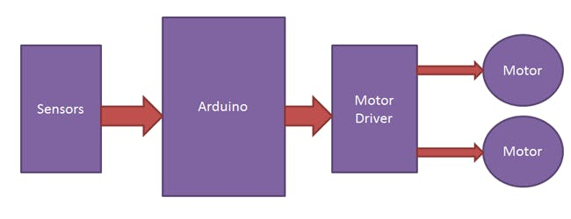
Block Diagram of working of the line tracking car

Slide 3
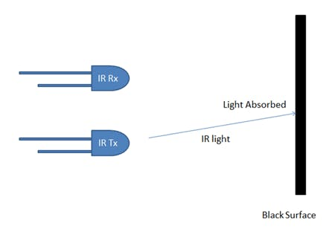
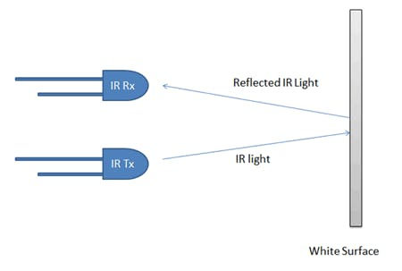
Concepts of line follower

Slide 4
When infrared ray incidents on the black surface , the ray gets absorbed by surface and the sensor output is 0 .
When the infrared ray incidents on colored surface , the ray gets reflected by surface and received by receiver so, output is 1.

Slide 6
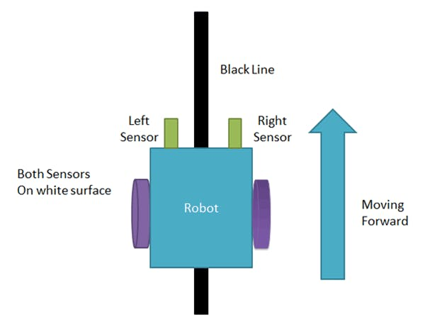
Sensor : IR1 = 1 , IR2 = 1

Slide 7
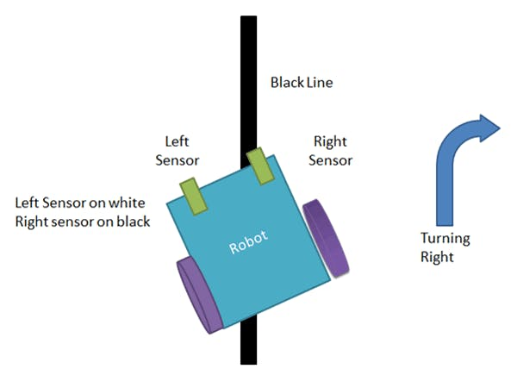
Sensor : IR1 = 1 , IR2 = 0

Slide 8
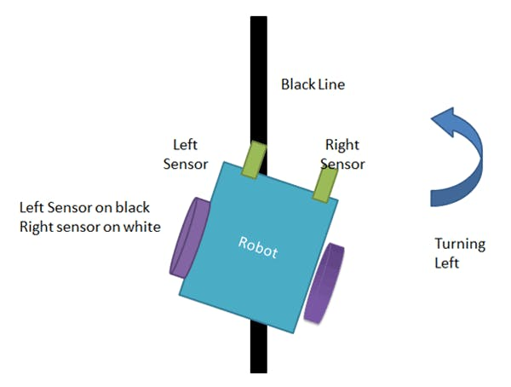
Sensor : IR1 = 0 , IR2 = 1

Slide 9
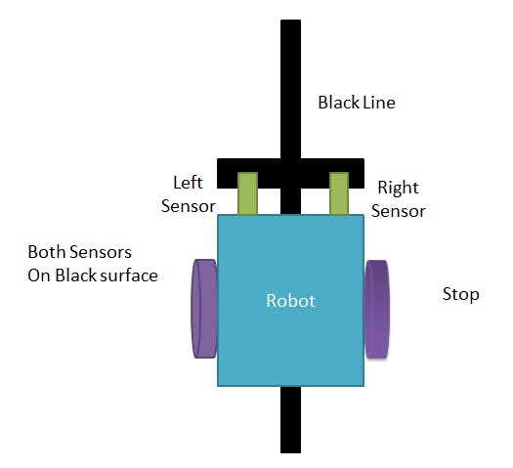
Sensor : IR1 = 0 , IR2 = 0

Slide 10
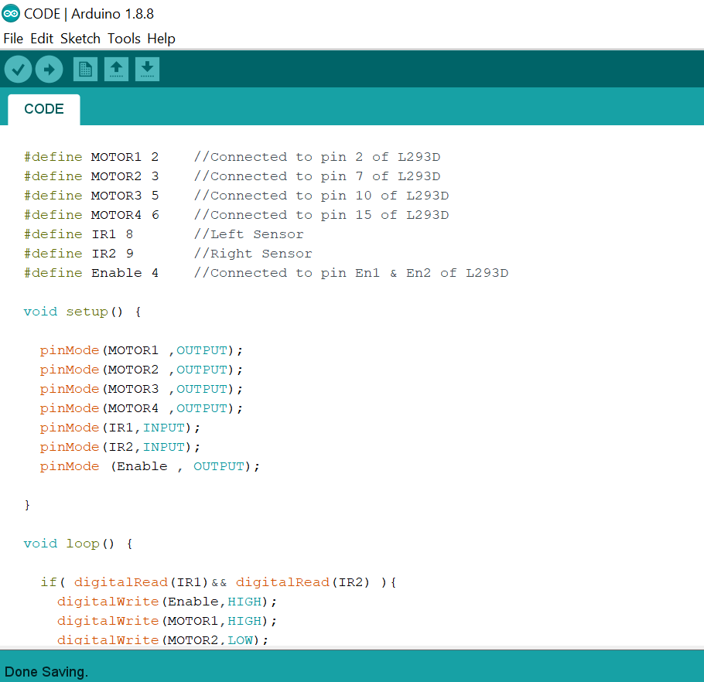

Slide 11
